Slide 1
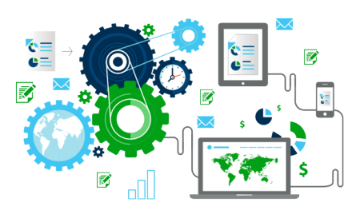
Web Scraping
Datasets generation for Machine Learning

Slide 2

What is Web Scraping ?
Data extraction from websites is known as Web Scraping.
Data can be in the form of Text, Images, Videos, Emails etc.
Large datasets can be generated by web scraping in very short time by automating the process.

Slide 3
Need of Web Scraping
Generate large valid datasets using technology within short time.
Training set for Machine Learning models,
Analysis of any company’s data, Competitive Analysis, Reputation Monitoring.
Content Aggregation (News API, Trivago, Job sites)
Real Time analysis (Sensex data)
Testing of websites. (proper working of websites)
Data can be generated in any required format like CSV, JSON.
Bulk data extracted can easily be stored in SQL/No-SQL databases.
Cost effective, Time saving.

Slide 4

Can you get in trouble for Web Scraping ?
Yes, you can get in trouble for Web Scraping.
Web Scraping may be against the terms of use of some websites.
Websites may or may not allow to get data extracted from them.

Slide 5
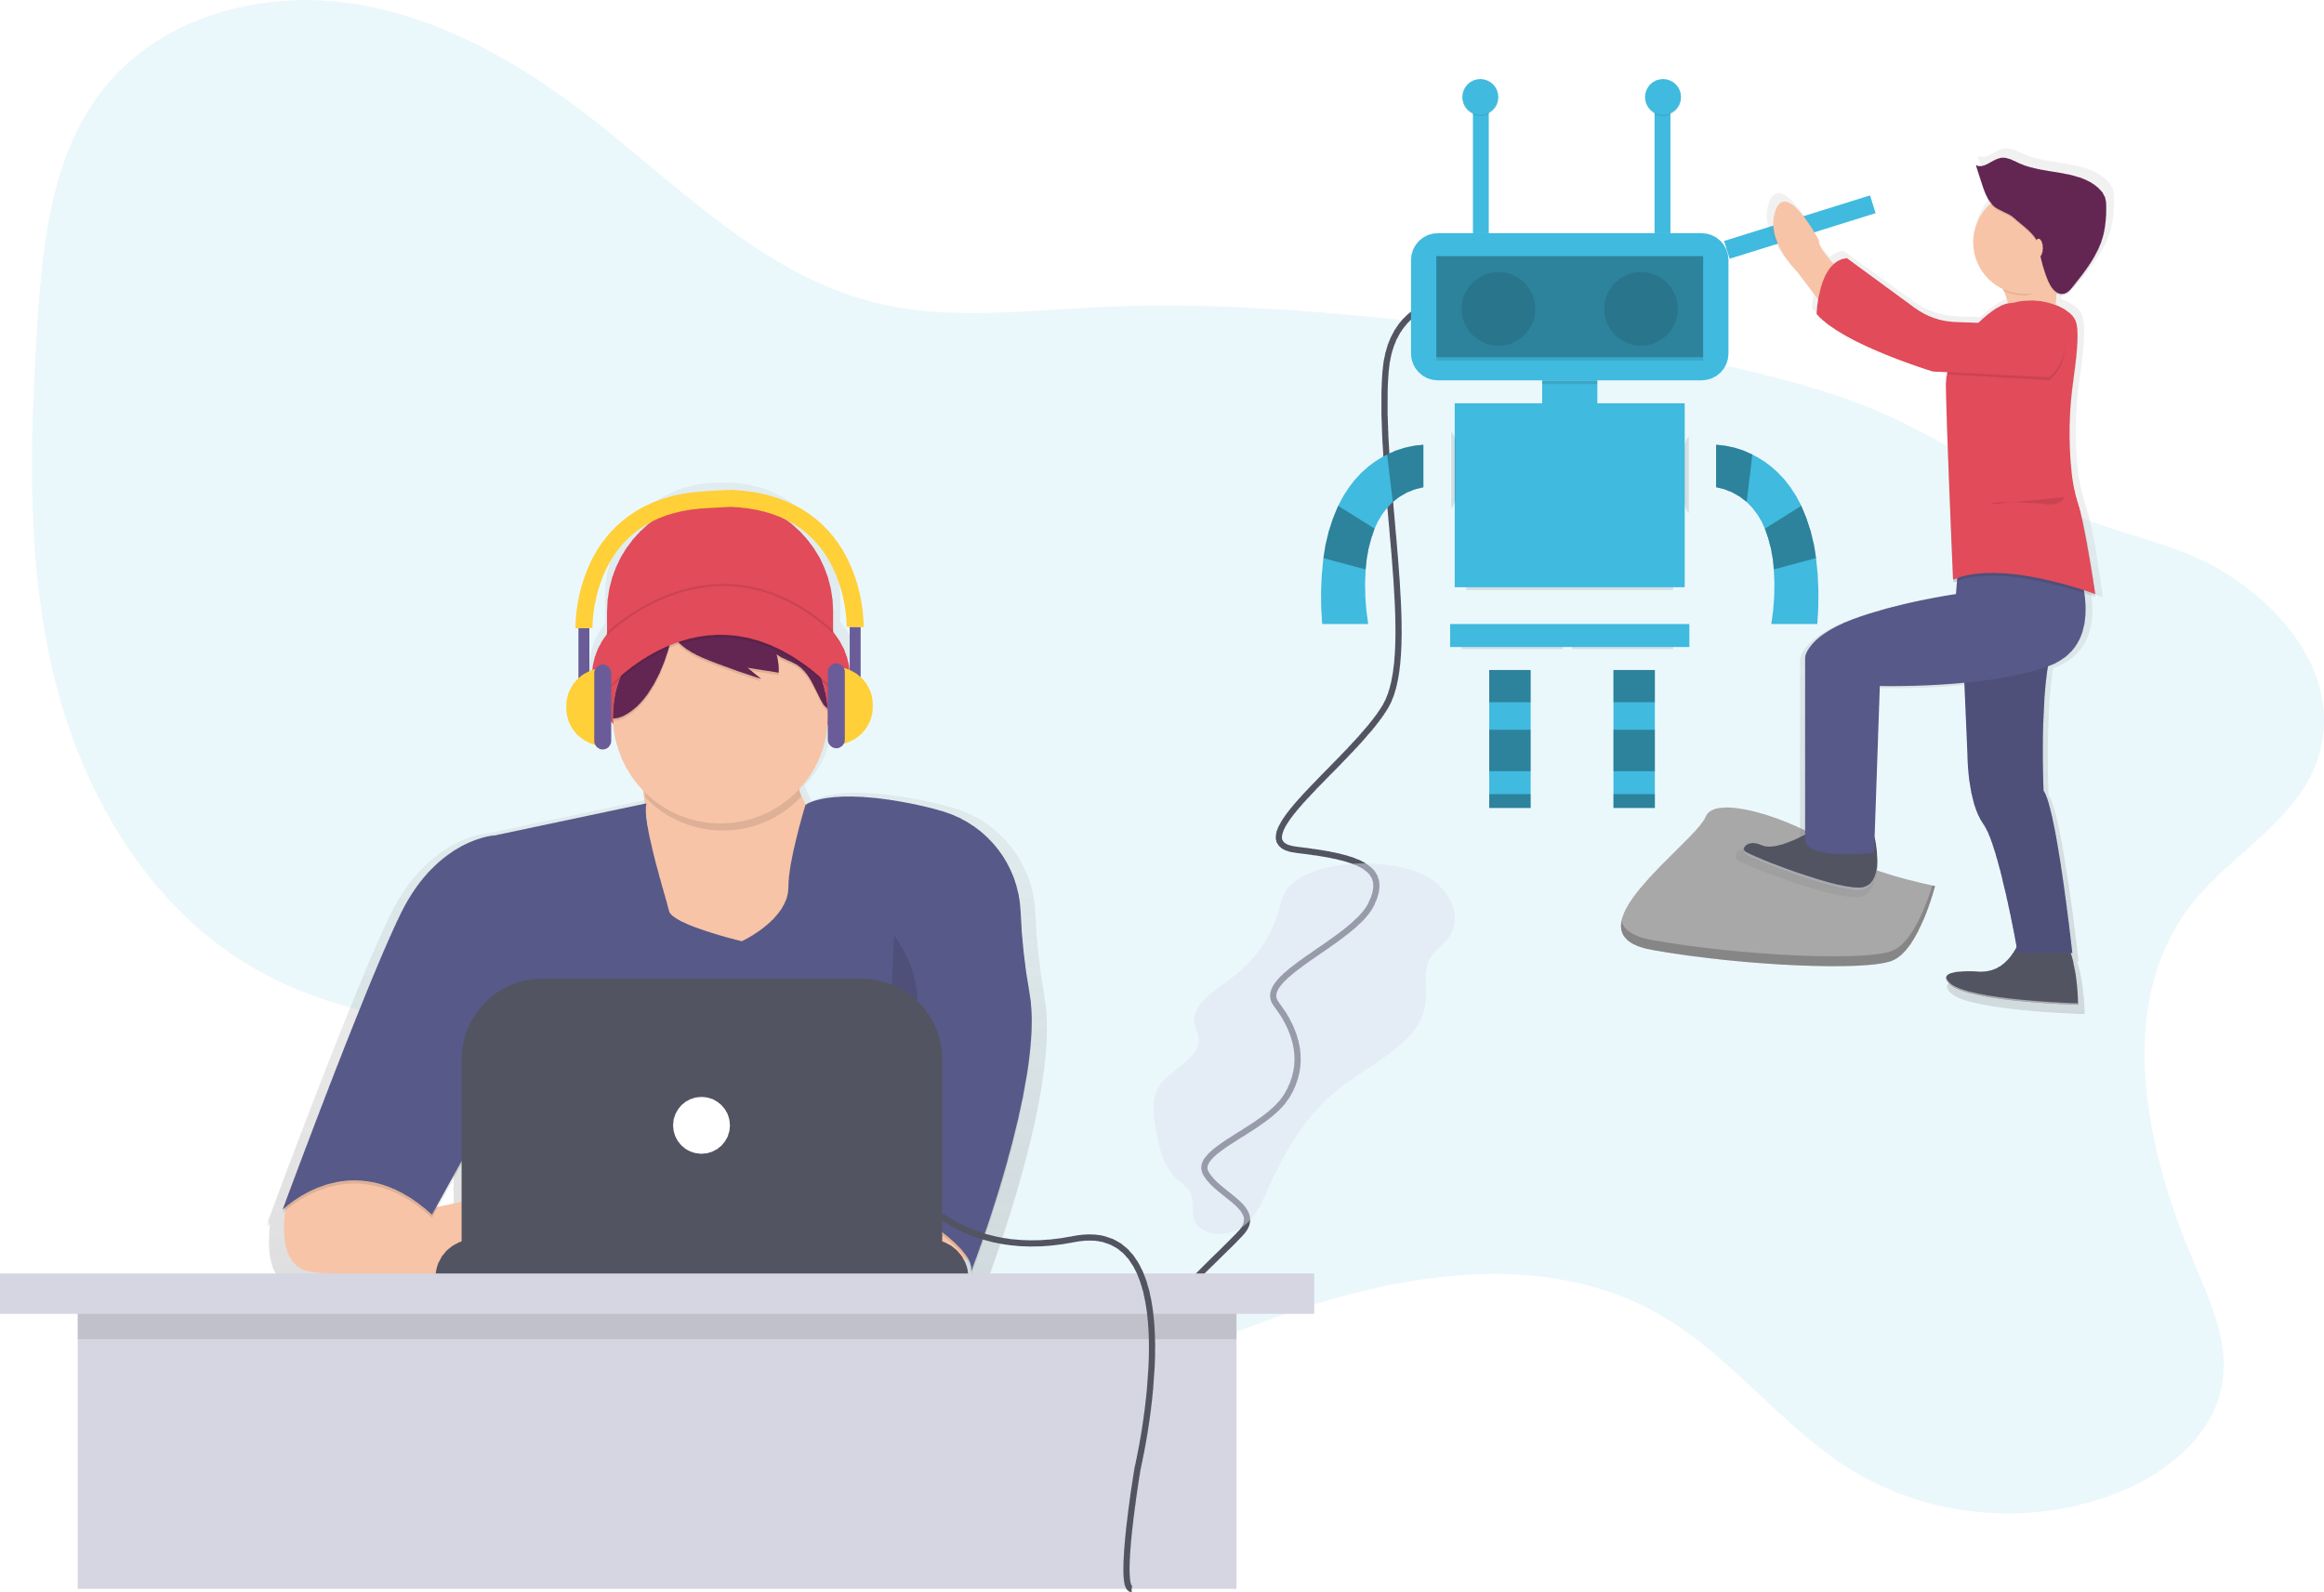
Are you allowed to Scrape me ?
Mostly all websites have robots.txt file, which contains:
User-Agent
Allow
Disallow
Example: Facebook - robots.txt

Slide 6



How are we going to do Web Scraping ?
We will be using these tools using Python:
Beautiful Soup - Beginner
Selenium - Automation
Scrapy – Pro

Slide 7
Prerequisites
HTML, CSS (Basics)
Python (Basics)
Anaconda Navigator (Python 3 Environment)
Web Browser (Google Chrome versions – 89/88)
Editor (VS Code recommended)
Good Internet Connection 😛

Slide 8
XPath vs CSS Selectors
XPath – XML Path Language
Language used for querying XML documents, we’ll be using here to query/select HTML tags from webpages.
CSS – Cascading Style Sheet
Language created for styling webpages, uses selectors to select specific elements/tags from webpages.

Slide 9
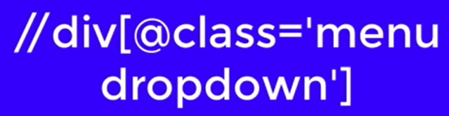

Which is preferred?
XPath has the ability to go up-down in a webpage. CSS does not provide that.
CSS has cleaner syntax than XPath.

Slide 10
CSS Selectors Practical
1. Open the link - try.jsoup.org/.
2. Paste the HTML code from sample.html
3. Cheat Sheet will be provided.

Slide 11
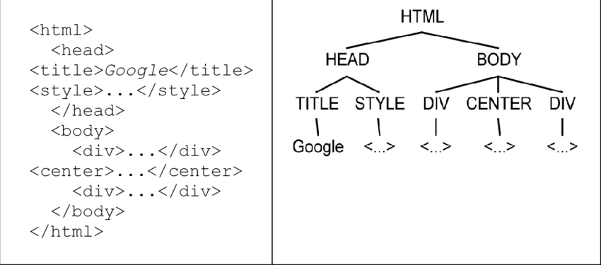
XPath Selectors Practical
1. Open the link - scrapinghub.github.io/xpath-playground/
2. Paste the HTML code from sample.html
3. Cheat Sheet will be provided.
4. We’ll be using XPath over CSS.

Slide 12
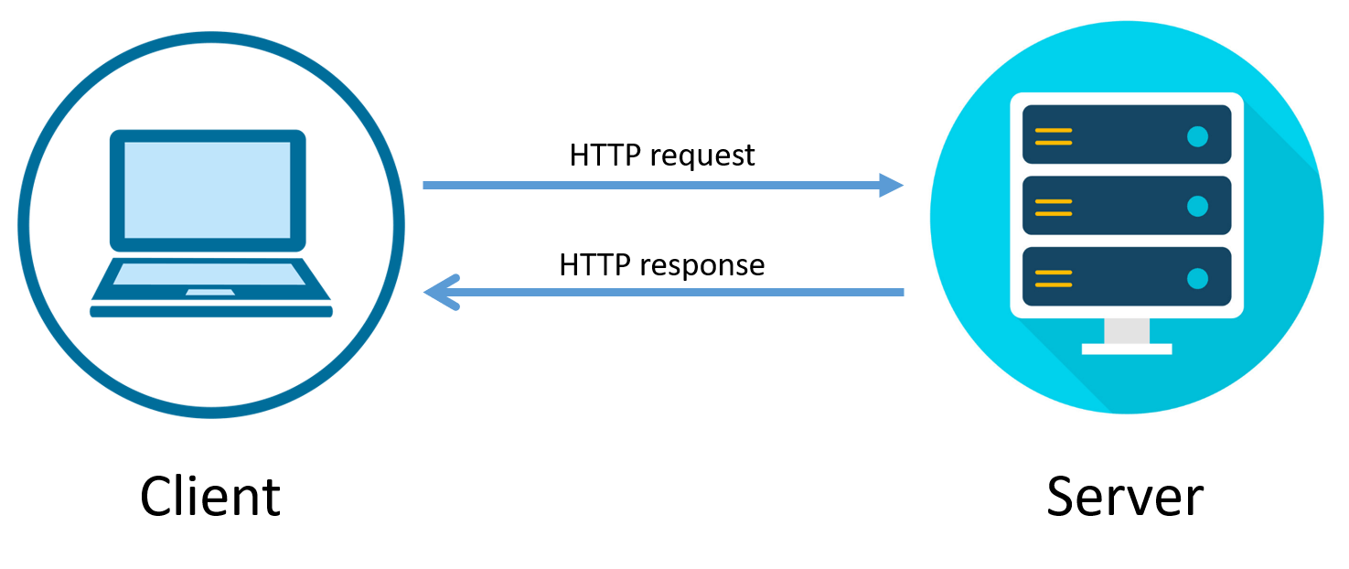
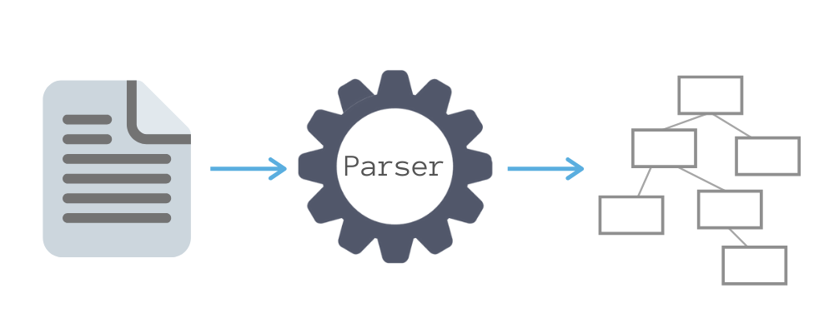
General Terms
Spider/Crawler – are classes which define how a certain site (or a group of sites ) will be scraped, including how to perform the crawl, how to extract structured data from their pages. (Google, Facebook have their own spiders)

Slide 13
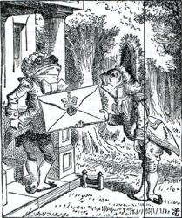
Beautiful Soup (Beginner)
Beautiful Soup is a Python library for pulling data out of HTML and XML files. It works with your favorite parser to provide idiomatic ways of navigating, searching, and modifying the parse tree. It commonly saves programmers hours or days of work.
Dependencies – requests (for making requests), parser (parse the extracted data)
Good enough for single pages. Easy Documentation, Good Community.

Slide 14
Beautiful Soup (Beginner)
Beautiful Soup
User – Friendly
Easy to Learn
Uses CSS Selectors, doesn’t supports XPath Selectors
Requires Dependencies
Inefficient / Slow
Not at all feasible for multiple pages(like thousands)
More Features to be revealed in Scrapy.
Converting to Dataset - Link

Slide 15

Selenium (Automation)
Selenium is a portable framework for testing web applications. Selenium provides a playback tool for authoring functional tests without the need to learn a test scripting language.
Selenium wasn’t originally designed for web scraping. In fact, Selenium is a web driver designed to render web pages for test automation of web applications.
This makes Selenium great for web scraping because many websites rely on JavaScript to create dynamic content on the page. Other web scraping tools like Beautiful Soup don’t have this functionality, limiting the extraction of data available on most websites.

Slide 16
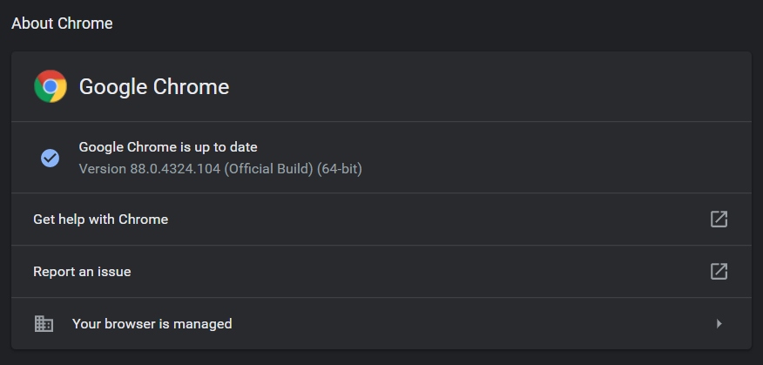
Selenium (Automation)

Slide 17
Selenium (Automation)
Web Driver is Required – All Drivers
Selenium – used with Java, Python, C#, Ruby.
Automation + Testing + Scraping in one.
Used for JS websites.
Not User Friendly. Not made for scraping.
Inefficient / Slow
Task – Try to navigate through pages of a website.

Slide 18
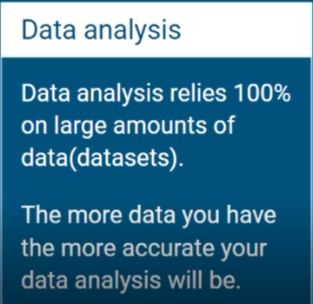
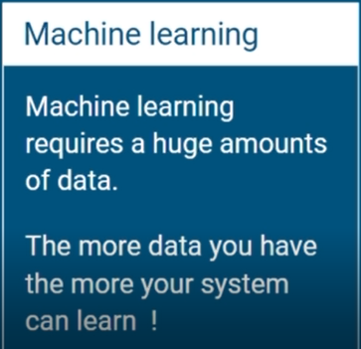
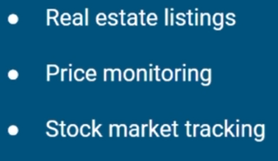
Break
Why Web Scraping?

Slide 19
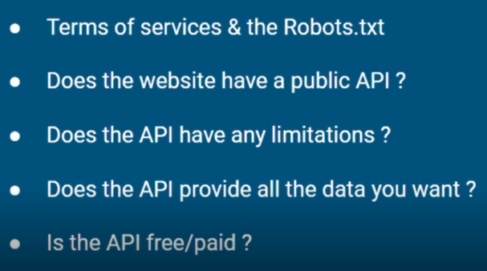
Break
When to/not to use Web Scraping?

Slide 20
Break
Challenges Faced
Websites change time to time.
Use of JavaScript in websites.
Shut down of websites.
Limited Requests per second.
Getting Banned on websites.
Hosting Spiders free of cost.

Slide 21

Scrapy (Pro)
Scrapy is a web scraping framework built especially for web scraping and written entirely in Python. It’s built on top of Twisted, an asynchronous network framework, which allows applications to respond to different network connections without using traditional threading models.
One of the biggest advantages of Scrapy is speed. Since it’s asynchronous, Scrapy spiders don’t have to wait to make requests one at a time, but it can make requests in parallel. This increases efficiency, which makes Scrapy memory and CPU efficient compared to the previous web scraping tools analyzed.
Some drawbacks of Scrapy is that it doesn’t handle JavaScript by default, but it relies on Splash to do the job. Also, the learning curve to learn Scrapy is steeper than tools like Beautiful Soup and the installation process and setup can be a bit complicated.

Slide 22
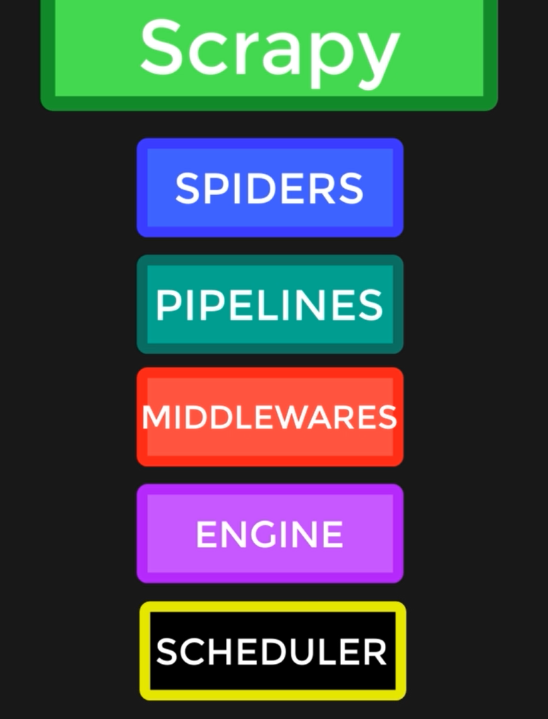
Scrapy (Pro)

Slide 23
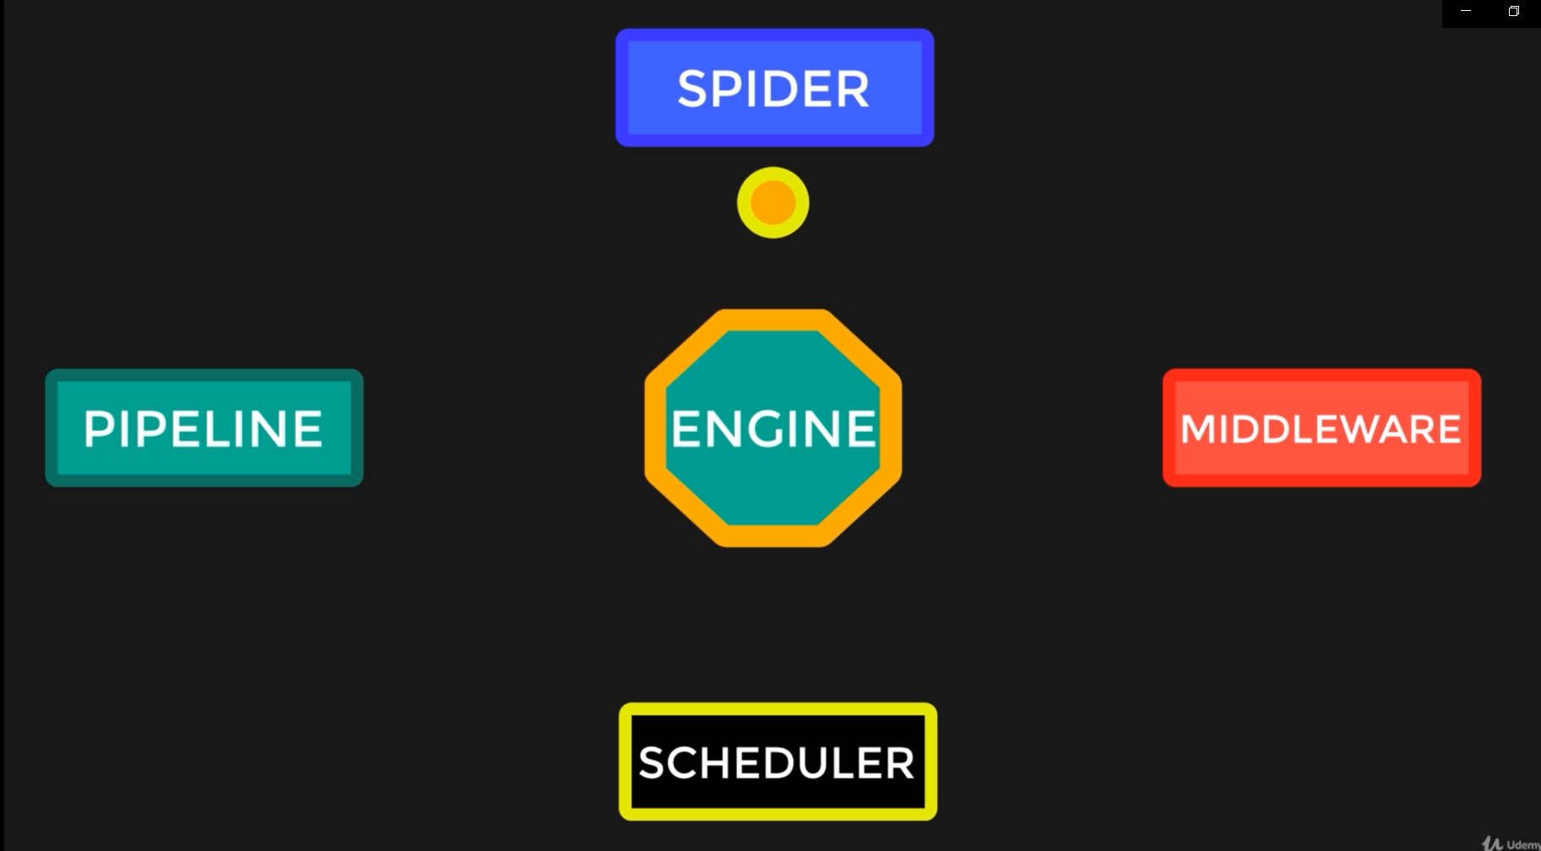
Scrapy (Pro) – Flow Link

Slide 24
Scrapy Additional Features
Scrapy can easily deal with multiple pages. (Pagination Handling)
Scrapy has the ability to handle infinite scrolling. (Instagram)
Spoofing Request Headers. (IMPORTANT)
Special Commands for debugging spiders.
For JavaScript websites, scrapy can collab with Splash & _______.
Data extracted by scrapy can be stored in databases like MongoDB, SQLite etc.
Spiders can be hosted!! (Heroku, ScrapingHub)
Store Images using Media pipeline.

Slide 25
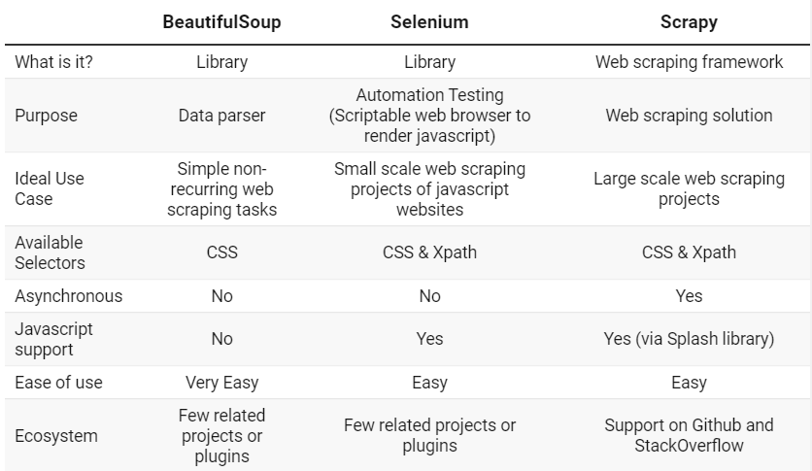
Comparison

Slide 26
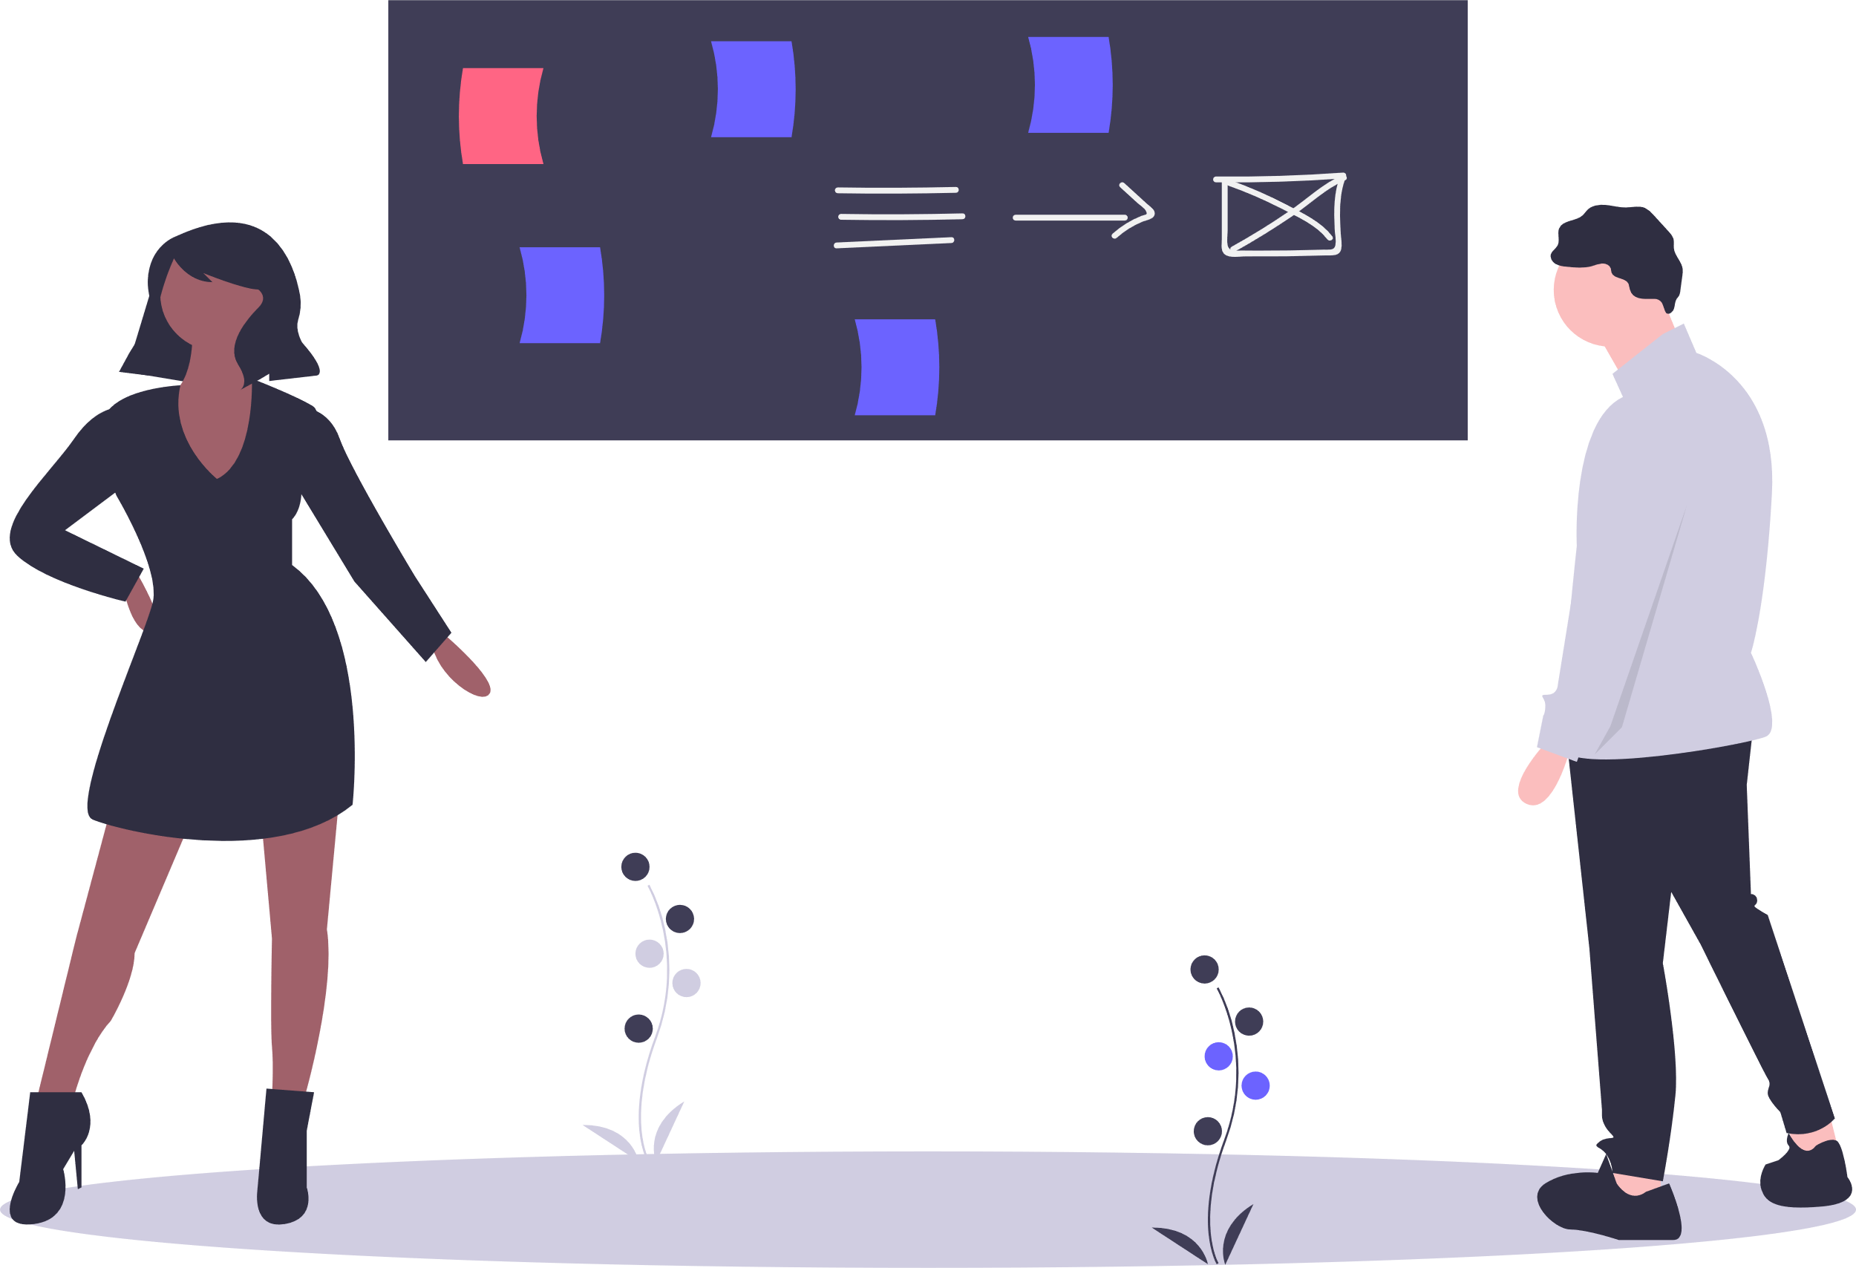
Demo
Techvents-Crawlers
Whatsapp Bot

Slide 27


